Slide 1
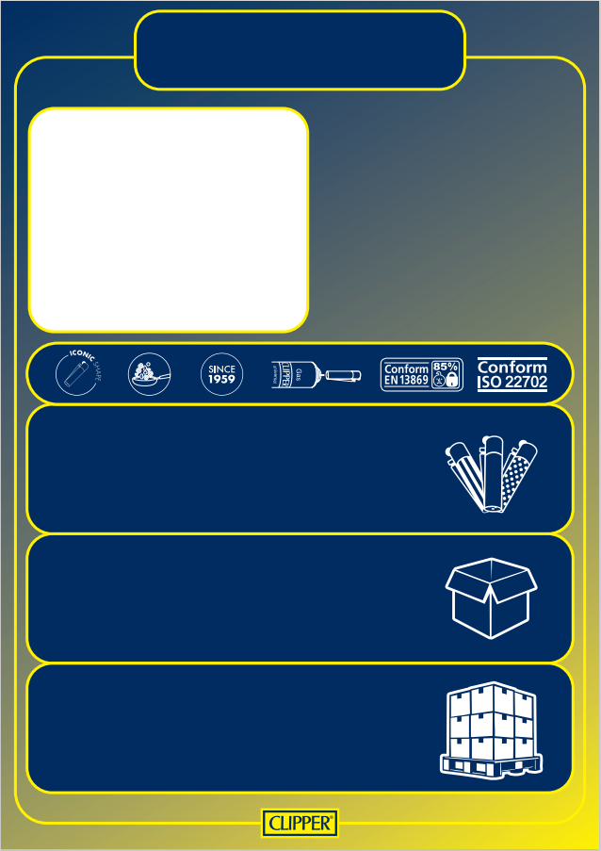
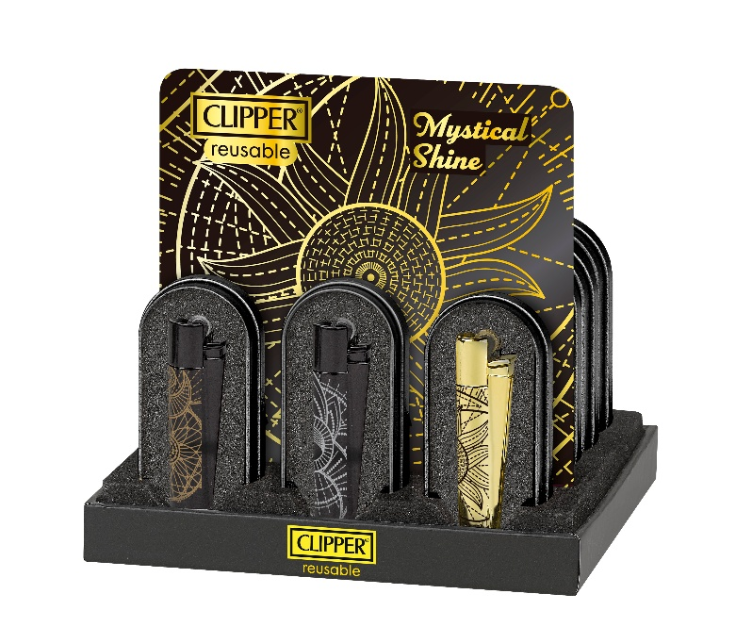



D48 CP22RH
FLUO ASSORTED
SKU: CM3S148X
Gas: 1,1 gr
Product Dimensions (mm): 77mm x 16,5mm
EAN unit: 8412765991899
Customs number: 9613.20.00.00
Display:
Content: 12 Lighters
Dimensions (mm): W(186), D(162), H(111)
Gross Weight (Kg): 1,015
EAN: 8412766113399
Master Carton:
Content: 8 Displays of 12 Lighters
Dimensions (mm): W(392), D(344), H(240)
Gross Weight (Kg): 8,313
EAN: 8412766113399
Pallet:
Content: 24 Master Carton
Dimensions (mm): 800 x 1.200 x 1.110
Gross Weight (Kg): 1.065,6
Stackeable : Yes

