Slide 1
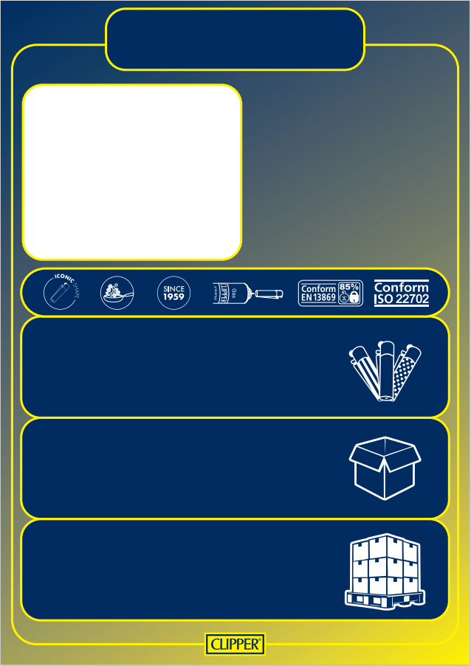
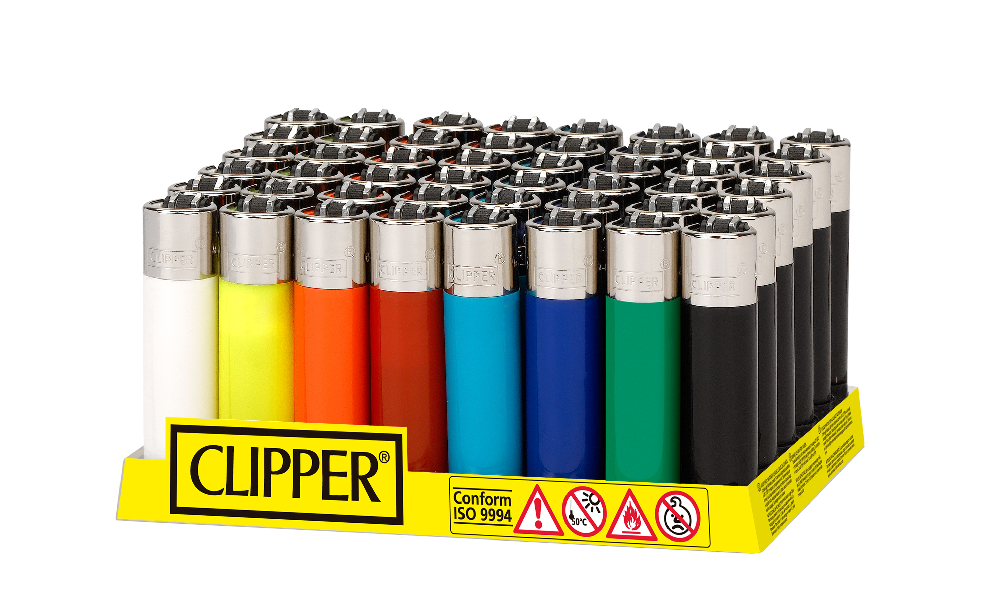



D48 CP22RH
FLUO ASSORTED
SKU: CP0A100FRH-
Gas: 1,9 gr
Product Dimensions (mm): 63mm x 14mm
EAN unit: N.A.
Customs number: 9613.20.00.00
Display:
Content: 48 Lighters
Dimensions (mm): W(122), D(122), H(650)
Gross Weight (Kg): 0,525
EAN: 8447218279552
Master Carton:
Content: 10 Displays of 48 Lighters
Dimensions (mm): W(337), D(258), H(155)
Gross Weight (Kg): 5,66
EAN: 8447218279552
Pallet:
Content: 56 Master Carton
Dimensions (mm): 800 x 1.200 x 1.270
Gross Weight (Kg): 358
Stackeable : Yes

